Slide 1
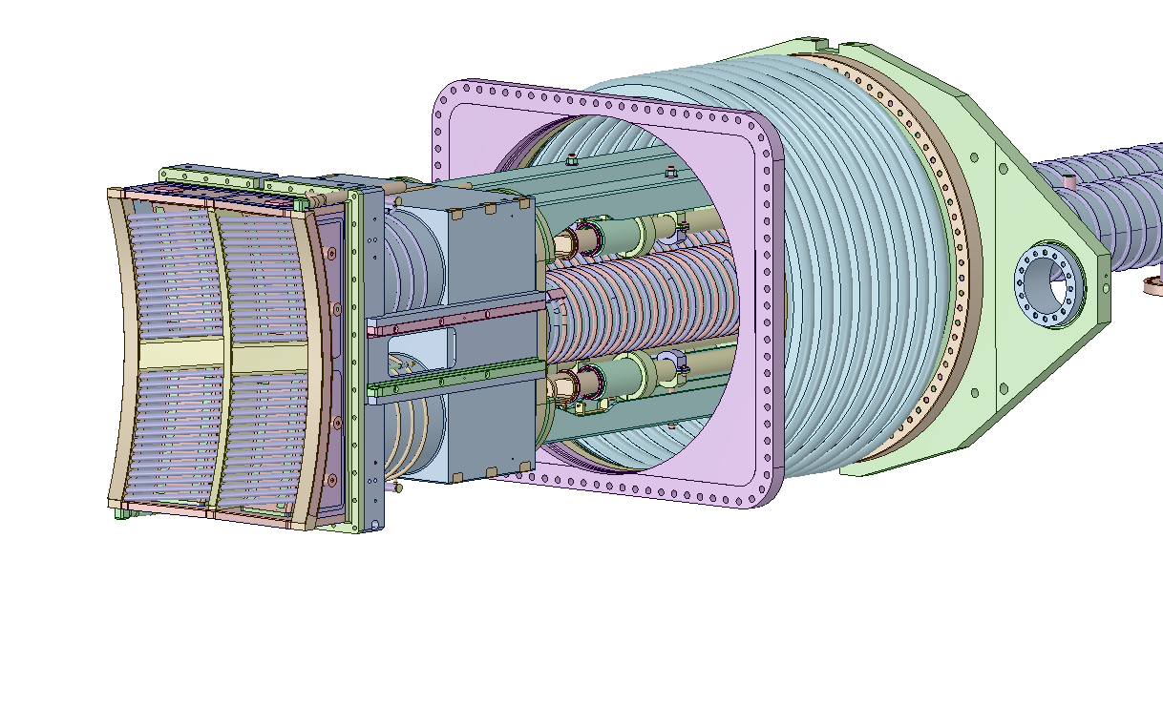

Slide 2
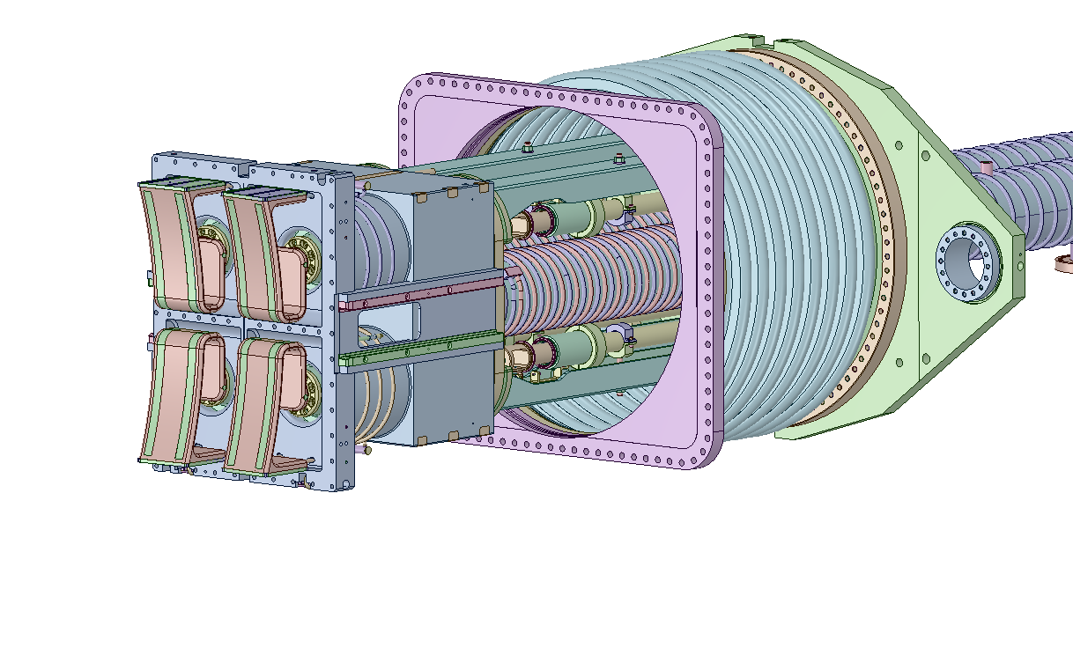

Slide 5
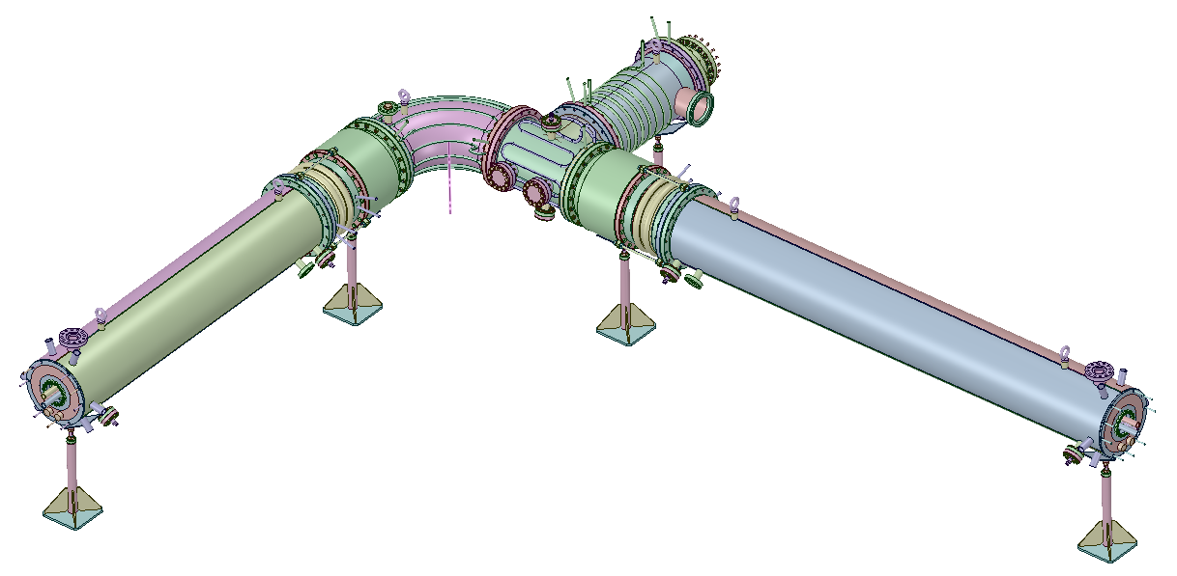
RF Input
RF probes
Short-circuits

Slide 6
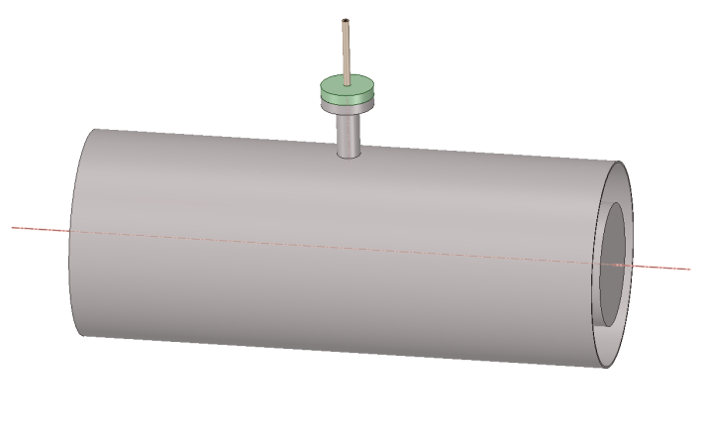
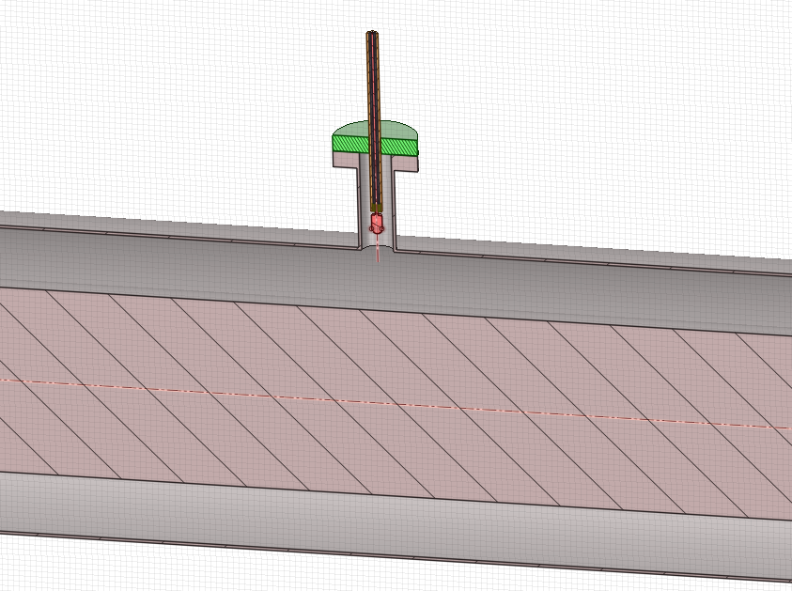
RF Voltage probe
Calibration setup
RF Input
Voltage probe
Probe plug
Coaxial line outer conductor
Coaxial line inner conductor

